Slide 1

Mr. Robins: AInsuRNNs
Ομάδα 5: Παρουσίαση εφαρμογής και ανάλυσης εφικτότητας υλοποίησης
Γεώργιος Μ. Μοσχόβης
Δημήτριος Μπούκας
Μαρίνα Ντόγκα
Αθήνα 24 Μαΐου, 2019

Slide 2


Mr. Robins Project: AInsuRNNs
We are innovating!
Challenge accepted!

Slide 3



Mr. Robins Project: AInsuRNNs
See it in action!

Slide 4


















Mr. Robins Project: AInsuRNNs
The Business Model Canvas
z
Key Partners
Key Activities
Value Proposition
Customer Relationships
Customers
Πλατφόρμα στην οποία είναι συγκεντρωμένα όλα τα διαθέσιμα πακέτα από διάφορες ασφαλιστικές και προτείνει τα κατάλληλα με βάση τις προτιμήσεις και τις ανάγκες του χρήστη.
Μεγαλύτερη ποικιλία και επιλογές ασφαλιστικών πακέτων σε μια πλατφόρμα, ελεύθερη στους χρήστες.
Οι τελικοί χρήστες της εφαρμογής, οι οποίοι θέλουν να βρουν ασφαλιστικά πακέτα.
Πλατφόρμα με ασφαλιστικά πακέτα.
Ασφαλιστικές
Ασφαλιστές
Online and International Payment
Προτάσεις πακέτων ή συνδυασμού πακέτων.
ικανοποίηση περισσότερων «ασφαλιστικών» αναγκών με πραγματικά στοιχεία... άμεσα, γρήγορα, συγκεντρωμένα.
Οι ασφαλιστές, οι οποίοι ψάχνουν τα κατάλληλα πακέτα ή συνδυασμό πακέτων για τους πελάτες.
Πώληση δεδομένων σε ασφαλιστικές .
Προσωποποιημένη πρόταση ασφαλιστικού πακέτου ή συνδυασμού πακέτων, τον πλέον καταλληλότερο με βάση τα χαρακτηριστικά- ανάγκες του πελάτη.
Key Resources
Οι ασφαλιστικές που αναζητούν δεδομένα για να δημιουργήσουν νέα, καταλληλότερα ασφαλιστικά πακέτα
Πλατφόρμα
Ασφαλιστικά προγράμματα
Ασφαλιζόμενοι
Channels
Συγκέντρωση δεδομένων με βάση τις αναζητήσεις των πελάτών για δημιουργία νέων ασφαλιστικών προγραμμάτων.
Android Playstore, iOs
Social Media
Search data portal
Cost Structure
Revenue Streams
Marketing
Servers
Online & International Payment
Pay per use
Subscription
Insurance
Human Resources

Slide 5
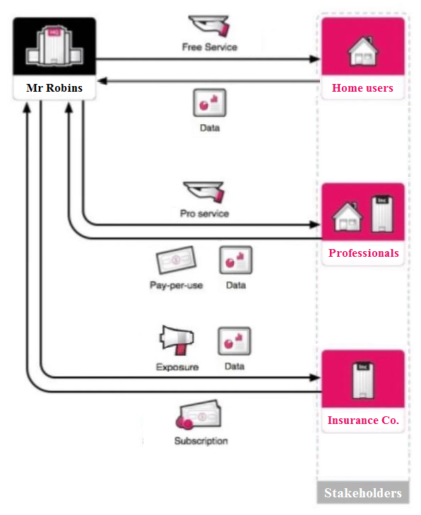
Mr. Robins Project: AInsuRNNs
The Business Model Kit
z
«σχέδιο ΙNsurSkroutz»
«σχέδιο insurer’s gun»
«πώληση δεδομένων πελατών InsurSkroutz στις εταιρείες»

Slide 6

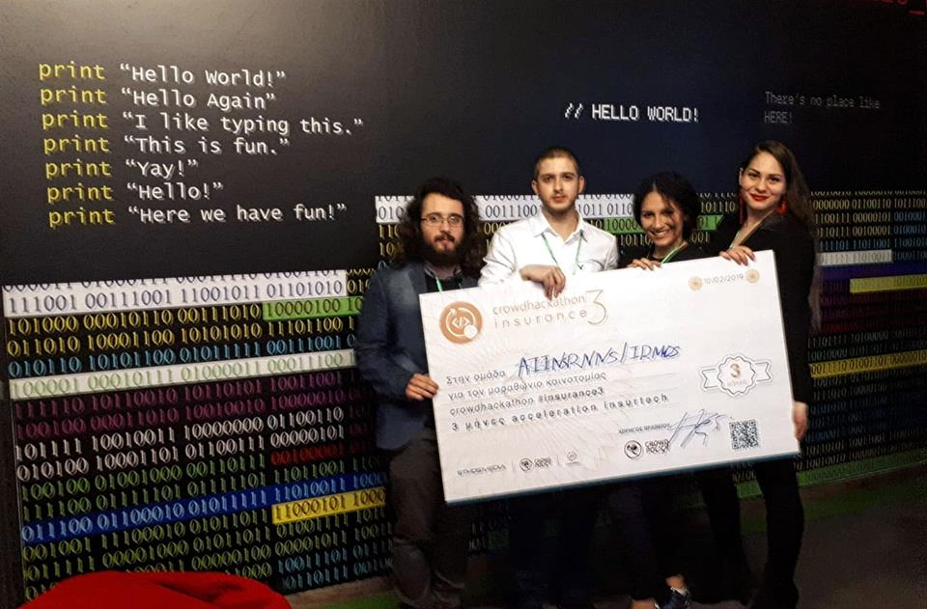
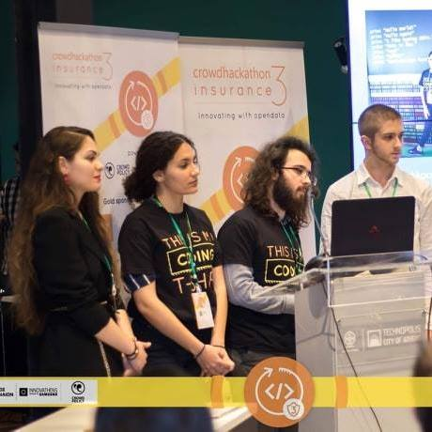
Mr. Robins Project: AInsuRNNs
Measuring innovation…
Company | Can deliver its own insurance product | Can provide personalized solutions | Has received recognition and awards | Is popular to the local market | Based on AI & Machine Learning
Our startup (AInsuRNNs) |  |  |  |  | 
 |  |  |  |  | 
Insurance Companies Web Apps |  |  |  |  | 
CrowdHackathon Insurance 3.0, Feb. 2019 – Awards
4th Place

Slide 7
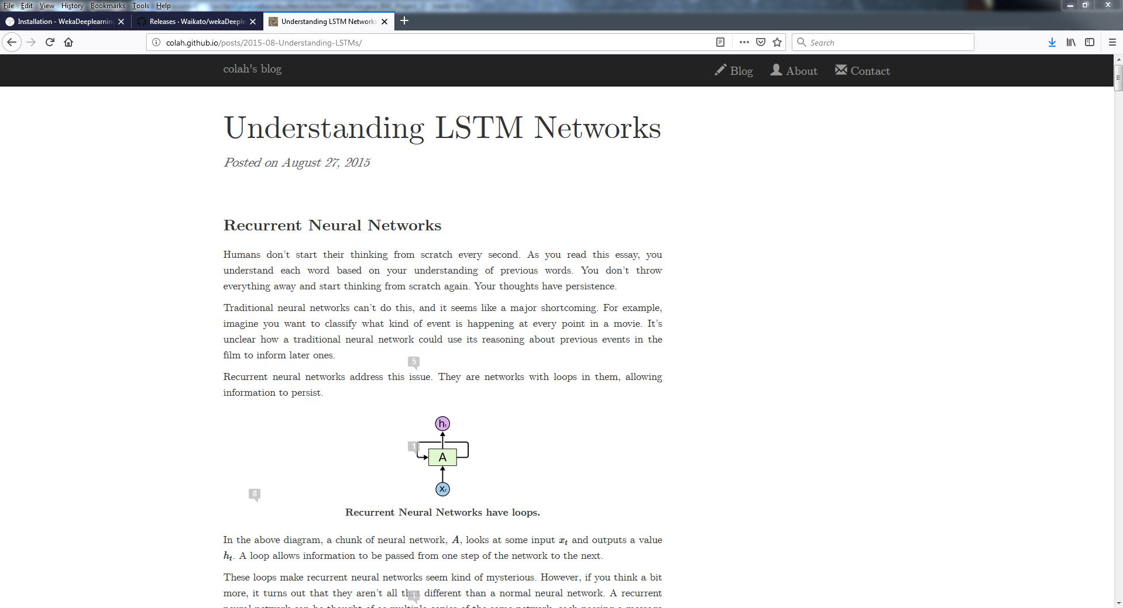
Mr. Robins Project: AInsuRNNs
Technology behind us!
Notes:
http://colah.github.io/posts/2015-08-Understanding-LSTMs/

Slide 8
Recurrent neural networks
Mr. Robins Project: AInsuRNNs
Technology behind us!
Slides for Chapter 10, Deep learning
of Data Mining by I. H. Witten, E. Frank,
M. A. Hall, and C. J. Pal

Slide 9
Recurrent neural networks
Recurrent neural networks are networks with connections that form directed cycles.
As a result, they have an internal state, which makes them prime candidates for tackling learning problems involving sequences of data—such as handwriting recognition, speech recognition, and machine translation.
A feedforward network can be transformed into a recurrent network by adding connections from all hidden units h_{i} to h_{j}.
Each hidden unit has connections to both itself and other hidden units.
Imagine unfolding a recurrent network over time by following the sequence of steps that perform the underlying computation.
Like a hidden Markov model, a recurrent network can be unwrapped and implemented using the same weights and biases at each step to link units over time.

Slide 10
Recurrent neural networks (RNNs)
An RNN can be unwrapped and implemented using the same weights and biases at each step to link units over time as shown below
The resulting unwrapped RNN is similar to a hidden Markov model, but keep in mind that the hidden units in RNNs are not stochastic
y₁
y₂
y_{M}
…
h₁
h₂
h_{L}
…
…
x₁
x₂
x_{K}
…

Slide 11
Recurrent neural networks (RNNs)
Recurrent neural networks apply linear matrix operations to the current observation and the hidden units from the previous time step, and the resulting linear terms serve as arguments of activation functions act():
The same matrix U_{h} is used at each time step
The hidden units in the previous step h_{t-1} influence the computation of h_{t} where the current observation contributes to a W_{h}x term that is combined with U_{h}h_{t-1} and bias b_{h} terms
Both W_{h} and b_{h} are typically replicated over time
The output layer is modeled by a classical neural network activation function applied to a linear transformation of the hidden units, the operation is replicated at each step.

Slide 12
The loss, exploding and vanishing gradients
The loss for a particular sequence in the training data can be computed either at each time step or just once, at the end of the sequence.
In either case, predictions will be made after many processing steps and this brings us to an important problem.
The gradient for feedforward networks decomposes the gradient of parameters at layer l into a term that involves the product of matrix multiplications of the form D^{(l)}W^{T(l+1)} (see the analysis for feedforward networks above)
A recurrent network uses the same matrix at each time step, and over many steps the gradient can very easily either diminish to zero or explode to infinity—just as the magnitude of any number other than one taken to a large power either approaches zero or increases indefinitely

Slide 13
Dealing with exploding gradients
The use of L₁ or L₂ regularization can mitigate the problem of exploding gradients by encouraging weights to be small.
Another strategy is to simply detect if the norm of the gradient exceeds some threshold, and if so, scale it down.
This is sometimes called gradient (norm) clipping where for a gradient vector g and threshold T,
where T is a hyperparameter, which can be set to the average norm over several previous updates where clipping was not used.

Slide 14
LSTMs and vanishing gradients
The so-called “long short term memory” (LSTM) RNN architecture was specifically created to address the vanishing gradient problem.
Uses a combination of hidden units, elementwise products and sums between units to implement gates that control “memory cells”.
Memory cells are designed to retain information without modification for long periods of time.
They have their own input and output gates, which are controlled by learnable weights that are a function of the current observation and the hidden units at the previous time step.
As a result, backpropagated error terms from gradient computations can be stored and propagated backwards without degradation.
The original LSTM formulation consisted of input gates and output gates, but forget gates and “peephole weights” were added later.
Below we present the most popular variant of LSTM RNNs which does not include peephole weights, but which does use forget gates.
The architecture is complex, but has produced state-of-the-art results on a wide variety of problems.

Slide 15
LSTM achitecture
At each time step there are three types of gates: input i_{t}, forget f_{t}, and output o_{t}.
Each are a function of both the underlying input x_{t} at time t as well as the hidden units at time t-1, h_{t-1}
Each gate multiplies x_{t} by its own gate specific W matrix, by its own U matrix, and adds its own bias vector b.
This is usually followed by the application of a sigmoidal elementwise non-linearity.
Notes:
At each time step t, input gates are used to determine when a potential input given by is important enough to be placed into the memory unit .

Slide 16
LSTM achitecture
At each time step t, input gates i_{t} are used to determine when a potential input given by s_{t} is important enough to be placed into the memory unit or cell, c_{t}
Forget gates f_{t} allow memory unit content to be erased
Output gates o_{t} determine whether y_{t} , the content of the memory units transformed by activation functions, should be placed in the hidden units h_{t}
Typical gate activation functions and their dependencies are shown below

Slide 17
LSTM achitecture
The final gating is implemented as an elementwise product between the output gate and the transformed memory contents, h_{t} = o_{t} ° y_{t}
Memory units are typically transformed by the tanh function prior to the gated output, such that y_{t}=tanh(c_{t})
Memory units or cells are updated by c_{t} = f_{t} ° c_{t-1}+ i_{t} ° s_{t} an elementwise product between the forget gates and the previous contents of the memory units, plus the elementwise product of the input gates and the new potential inputs .

Slide 18
LSTM achitecture

Slide 19
Other RNN architectures
Recurrent networks can be made bidirectional, propagating information in both directions
They have been used for a wide variety of applications, including protein secondary structure prediction and handwriting recognition
An “encoder-decoder” network creates a fixed-length vector representation for variable-length inputs, the encoding can be used to generate a variable-length sequence as the output
Particularly useful for machine translation
a)
b)
…
…
…

Slide 20
Deep encoder-decoder architectures
Given enough data, a deep encoder-decoder architecture such as that below can yield results that compete with translation systems that have been hand-engineered over decades of research.
The connectivity structure means that partial computations in the model can flow through the graph in a wave, illustrated by the darker nodes in the figure
…
…
Notes:
Given enough data, a deep encoder-decoder architecture such as that of Figure 10.18 can yield results that compete with systems that have been hand-engineered over decades of research. The connectivity structure means that partial computations in the model can flow through the graph in a wave, illustrated by the darker nodes in the Figure

Slide 21
Bibliographic Notes & Further Reading
Recurrent neural networks
Graves et al. (2009) demonstrate how recurrent neural networks are particularly effective at handwriting recognition,
Graves et al. (2013) apply recurrent neural networks to speech.
The form of gradient clipping presented above was proposed by Pascanu et al. (2013).
Hochreiter and Schmidhuber (1997) is the seminal work on the “Long Short-term Memory” architecture for recurrent neural networks;
our explanation follows Graves and Schmidhuber (2005)’s formulation.
Greff et al. (2015)’s paper “LSTM: A search space odyssey” explored a wide variety of variants and finds that:
none of them significantly outperformed the standard LSTM architecture; and
forget gates and the output activation function were the most critical components. Forget gates were added by Gers et al. (2000).
Notes:
IRNNs were proposed by Le et al. (2015), while Chung et al. (2014) proposed gated recurrent units and Schuster and Paliwal (1997) proposed bidirectional recurrent neural networks. Chen and Chaudhari (2004) used bi-directional networks for protein structure prediction, while Graves et al. (2009) used them for handwriting recognition. Cho et al. (2014) used encoder-decoder networks for machine translation, while Sutskever et al. (2014) proposed deep encoder-decoder networks and used them with massive quantities of data.
For further accounts of advances in deep learning and a more extensive history of the field, consult the reviews of LeCun et al. (2015), Bengio (2009), and Schmidhuber (2015).

Slide 22
Bibliographic Notes & Further Reading
Recurrent neural networks
IRNNs were proposed by Le et al. (2015)
Chung et al. (2014) proposed gated recurrent units
Schuster and Paliwal (1997) proposed bidirectional recurrent neural networks
Chen and Chaudhari (2004) used bi-directional networks for protein structure prediction; Graves et al. (2009) used them for handwriting recognition
Cho et al. (2014) used encoder-decoder networks for machine translation, while Sutskever et al. (2014) proposed deep encoder-decoder networks and used them with massive quantities of data
For further accounts of advances in deep learning and a more extensive history of the field, consult the reviews of LeCun et al. (2015), Bengio (2009), and Schmidhuber (2015)
Notes:
IRNNs were proposed by Le et al. (2015), while Chung et al. (2014) proposed gated recurrent units and Schuster and Paliwal (1997) proposed bidirectional recurrent neural networks. Chen and Chaudhari (2004) used bi-directional networks for protein structure prediction, while Graves et al. (2009) used them for handwriting recognition. Cho et al. (2014) used encoder-decoder networks for machine translation, while Sutskever et al. (2014) proposed deep encoder-decoder networks and used them with massive quantities of data.
For further accounts of advances in deep learning and a more extensive history of the field, consult the reviews of LeCun et al. (2015), Bengio (2009), and Schmidhuber (2015).

Slide 23
Deep learning software
Deeplearning4j
Java-based open-source deep learning library available under the Apache 2.0 license
Uses an multidimensional array class and provides linear algebra and matrix manipulation support similar to that provided by Numpy

Slide 24
Weka support for deep learning
Deep learning can be implemented in WEKA using three methods:
With the wrapper classifiers for the third-party DeepLearningForJ package that are available in the deepLearningForJ package
Using the MLRClassifier from the RPlugin package to exploit deep learning implementations in R
By accessing Python-based deep learning libraries using the PyScript package

Slide 25
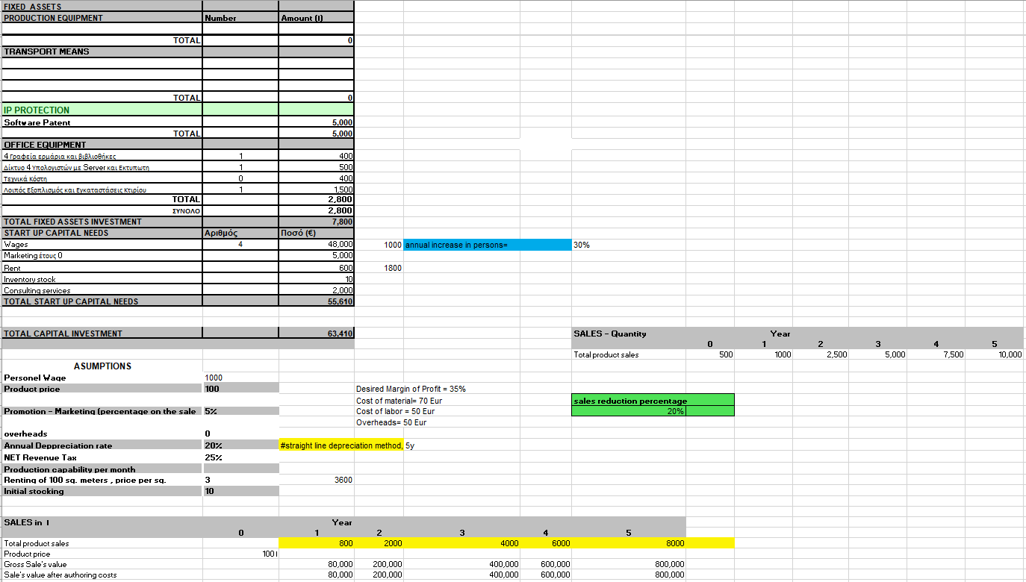
Mr. Robins Project: AInsuRNNs
Sensitivity Analysis
z

Slide 26
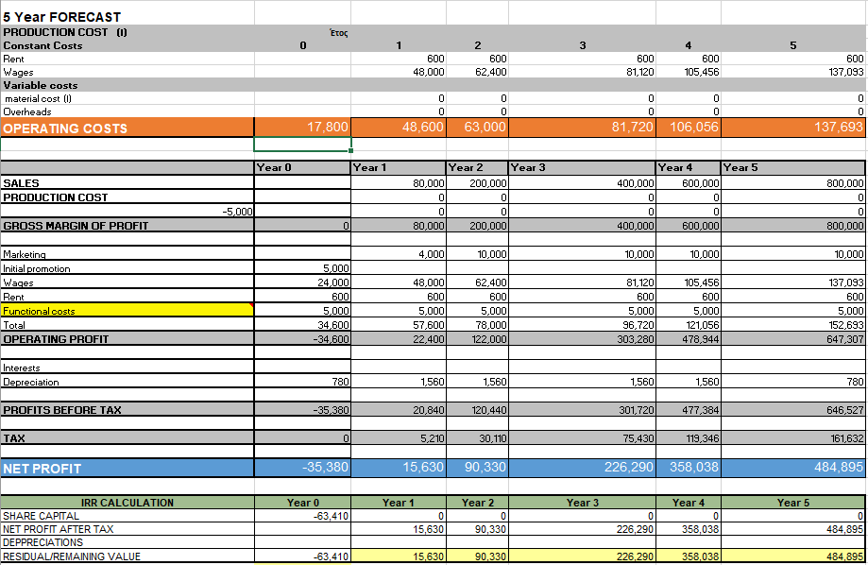
Mr. Robins Project: AInsuRNNs
Sensitivity Analysis
z
Net Present Value (NPV) = 361.018
Notes:
Net present value (NPV) is the difference between the present value of cash inflows and the present value of cash outflows over a period of time. NPV is used in capital budgeting and investment planning to analyze the profitability of a projected investment or project

Slide 27
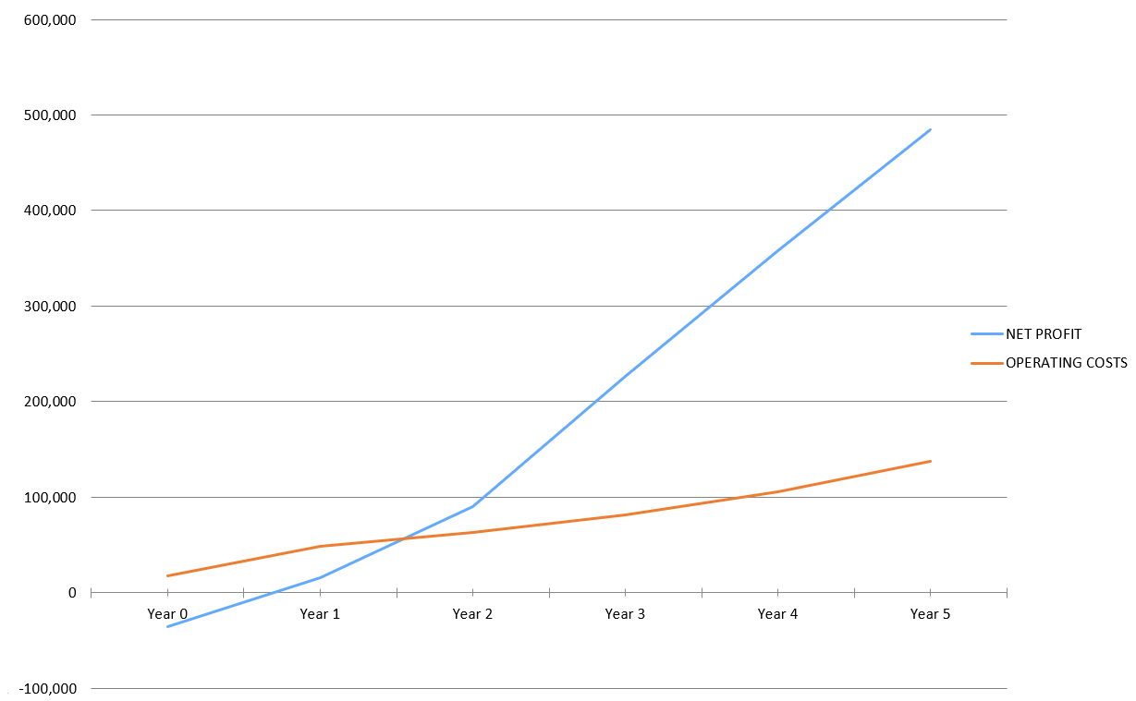
Mr. Robins Project: AInsuRNNs
Sensitivity Analysis
z

Slide 28
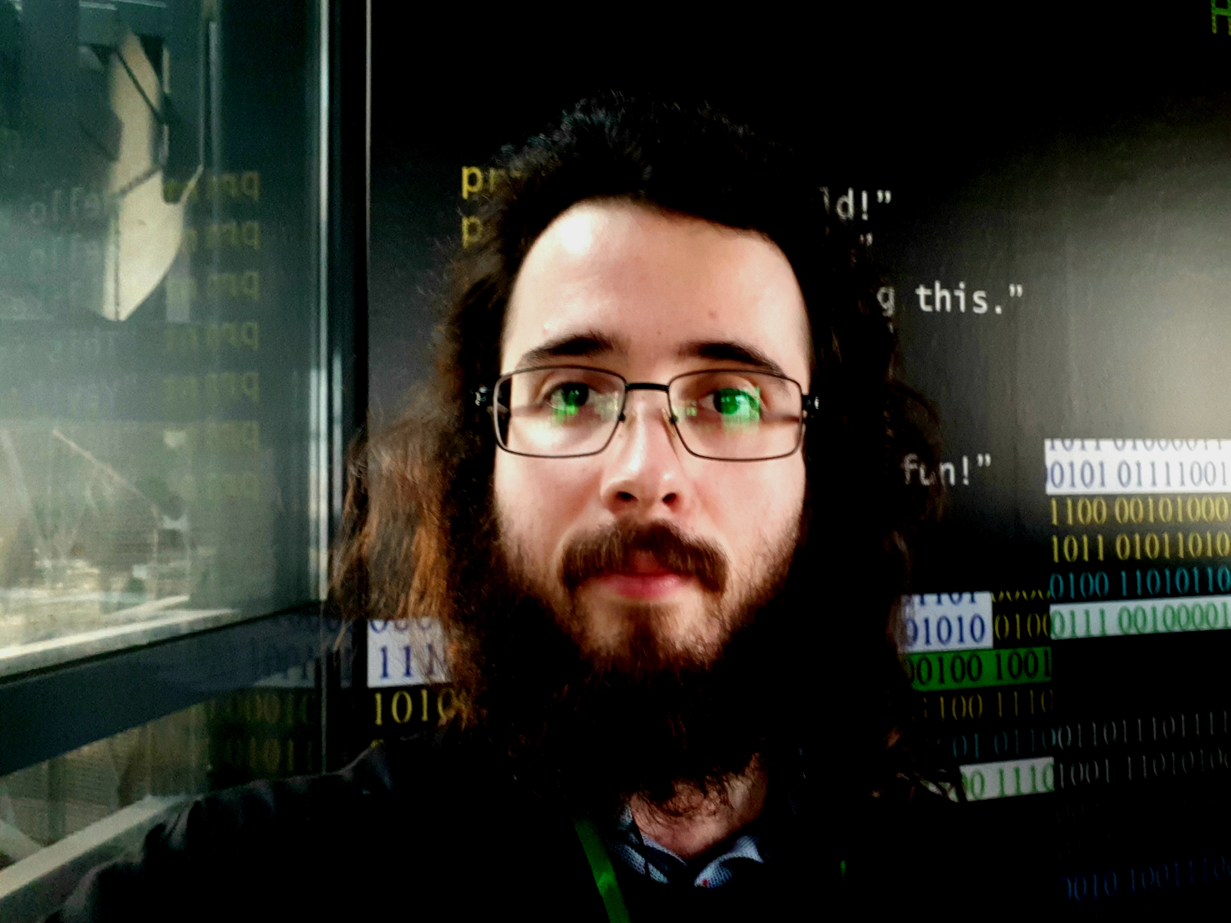
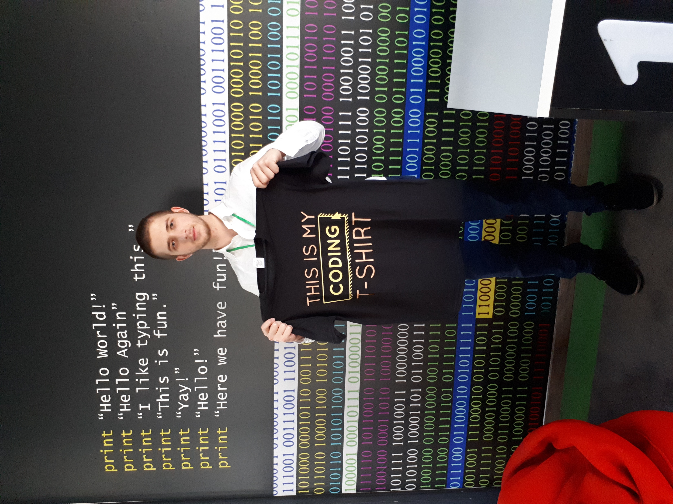
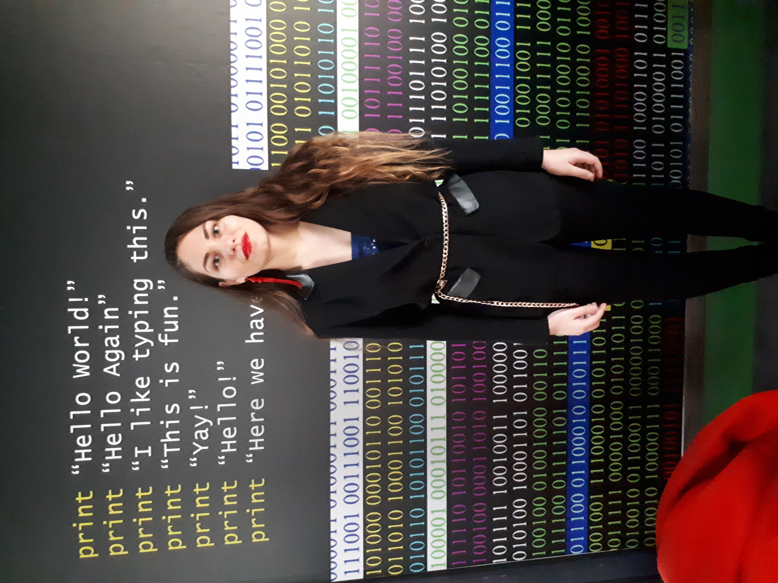

Mr. Robins Project: AInsuRNNs
Our team
z
Μπούκας Δημήτριος
Data Mining Expert & Coder
Μοσχόβης Γεώργιος
Artificial Intelligence
Expert & Coder
Ντόγκα Μαρίνα
Επιχειρησιακή Έρευνα
bit.do/linkedIn_georg_mosh

Slide 29
Mr. Robins Project: AInsuRNNs
Thank you for your attention!

